Slide 1
CF Estimation
Estimating characteristic function from experiments

Slide 2
Introduction
Characteristic functionals are one of the main analytical tools used to quantify the statistical properties of random functions.
Random function is the correct model for the ensemble of objects being imaged by a given imaging system.
Examples:
In x-ray computed tomography, this function gives the x-ray attenuation at each point
Position emission tomography and single photon emission computed tomography imaging, this function gives the activity distribution inside the body
While there are anatomical structures that are common to all patients, there are also unpredictable variations in these structures throughout the patient population.

Slide 3
Intro. Cont.
Any given attenuation map or activity distribution can be regarded as a realization of a random function
There will be unpredictable variations in the function being imaged. Otherwise the object function would be known.

Slide 4



Frequency Response
$L\left\{x\left(t\right)\right\}=X\left(s\right)=\int{x(t)e^{−st}dt} F\left\{x\left(t\right)\right\}=X\left(jw\right)=\int{x(t)e^{−jwt}dt}$
Transfer function Frequency response
$H\left(jw\right)=\left|H\left(jw\right)\right|.e^{j∠H(jw)}=amplitude.e^{phase}$
What is amplitude and phase in case of images?
$amplitude=\sqrt{{real}^{2}+{img}^{2}}$
$phase=arctan2\left(\frac{img}{real}\right)$
$$s=jω$$
$$s=jω$$

Slide 5
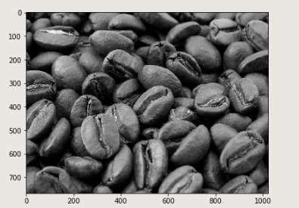
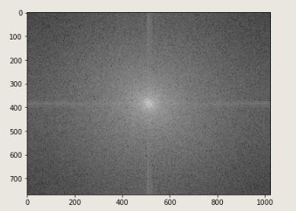
Frequency Response cont.
The response of each image is our experiments
We are looking for a generalized distribution that can represent the entire samples from experiments for a describe a particular object.

Slide 6
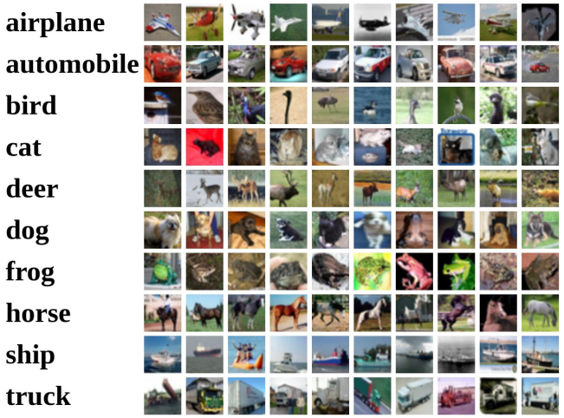

Frequency Response cont.
If we assume that a MLP is the optimal function approximation tool, then target will be like this:
CIFAR10 dataset and its corresponding weight visualizations as the distribution that can represent each class

Slide 7

Frequency Response cont.
From depictions in the previous slide, we can see that the corresponding model of each class is very similar to average of all images(responses) of that particular class.
We assume that the random function is specified by a parameter vector $θ$
Our goal is produce an estimate for $θ$ from the data generated by $f(r|θ)$ where $X_{r}=f(r, ω)$ is a random variable for each $r$ and $ω$ in sample set $S$ and $Ω$ respectively.

Slide 8

Frequency Response cont.
Consider a sample $\{f_{1}\left(r | θ\right),f_{2}\left(r | θ\right),…,f_{n}(r|θ)\}$ of independent realizations and the corresponding data matrix $G=\left\{g_{1},g_{2},…,g_{n}\right\}$
We can form an estimate $\hat{Φ_{g}}$ of $Φ_{g}$ by using a sample mean:
$$\hat{Φ_{g}}\left(ζ | θ\right)=\frac{1}{N}\sum_{n=1}^{∞}{f_{n}}$$

Slide 9
Reference
http://www.ee.ic.ac.uk/pcheung/teaching/DE2_EE/Lecture%208%20-%20Frequency%20Responses%20(x1).pdf
Clarkson, E., & Barrett, H. H. (2016). Characteristic functionals in imaging and image-quality assessment: tutorial. Journal of the Optical Society of America. A, Optics, image science, and vision, 33(8), 1464–1475. https://doi.org/10.1364/JOSAA.33.001464

